Slide 1
Credit Card Transactions - Insights Report
Based on Power BI Dashboard Analysis

Slide 2
Executive Summary
The Credit Card Transaction report highlights key business insights based on customer spending behavior, revenue, and transactions. The analysis provides trends across demographics, expenditure categories, and card types.

Slide 3
Revenue Overview
- Total Revenue: $55M
- Total Transactions: 656K
- Total Interest Earned: $8M
- Transaction Amount: $45M
Quarterly Trend: Revenue fluctuated across Q1–Q4 with Q2 showing higher performance.

Slide 4
Revenue by Card Type
- Blue Card generated the highest revenue: $46M
- Silver: $5.6M, Gold: $2.4M, Platinum: $1.1M
- Blue cards dominate both revenue and transaction amounts.

Slide 5
Customer Demographics Insights
- Revenue by Income: High-income customers contributed $22M
- Age 50–60 contributed maximum revenue ($14M), followed by 40–50 ($11M)
- Married customers ($15M) spend more than singles ($11M)
- Males contribute $30M vs Females $25M

Slide 6
Revenue by Occupation
- Businessmen generated highest revenue ($17M)
- White-collar jobs: $10M
- Govt Employees: $8M
- Self-employed: $8M
- Blue-collar & Retirees contribute relatively less.

Slide 7
Spending Patterns
- Top Expenditure Categories:
* Travel ($7M)
* Entertainment ($5M)
* Food & Grocery ($5M each)
* Fuel & Bills ($4M each)
- Customers spend heavily on lifestyle and travel.

Slide 8
Regional Insights
- Top 5 Revenue Generating States:
* California (CA): $7M
* New Jersey (NJ): $7M
* New York (NY): $6M
* Texas (TX): $6M
* Florida (FL): $4M

Slide 9
Key Takeaways & Recommendations
- Focus marketing on Blue card users as they drive maximum revenue.
- Target age group 40–60 with premium offers.
- Increase campaigns for high-income & businessman segments.
- Promote travel & lifestyle-related offers.
- Explore growth opportunities in high-revenue states like CA & NJ.

Slide 10
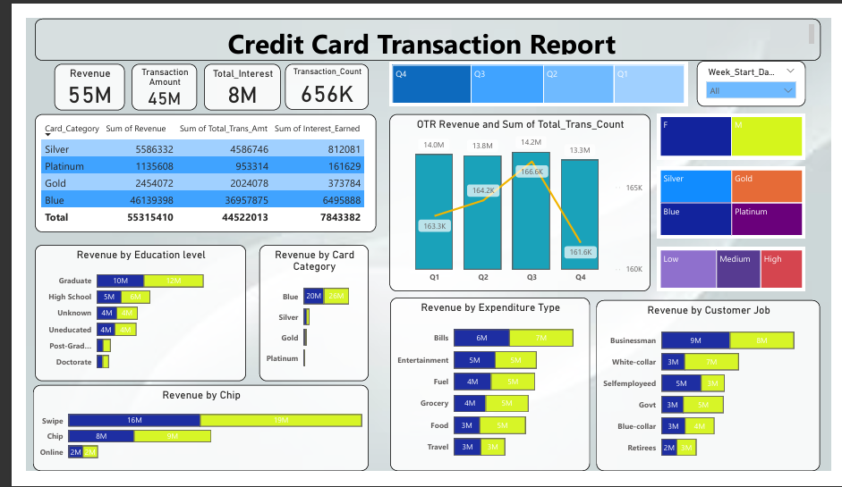
Dashboard View: Credit Card Transaction Report

Slide 11
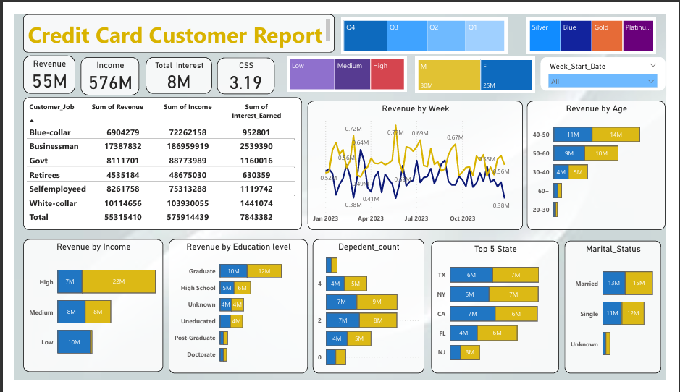
Dashboard View: Credit Card Customer Report

